Slide 1


Referral Program AB Testing Report
Audience assumption:
Internal meeting with PM

Slide 2
Content
1.
Background
2.
Executive Summary
3.
Business Flow
4.
Analysis
5.
Finding & Conclusion

Slide 3
Background

Slide 4
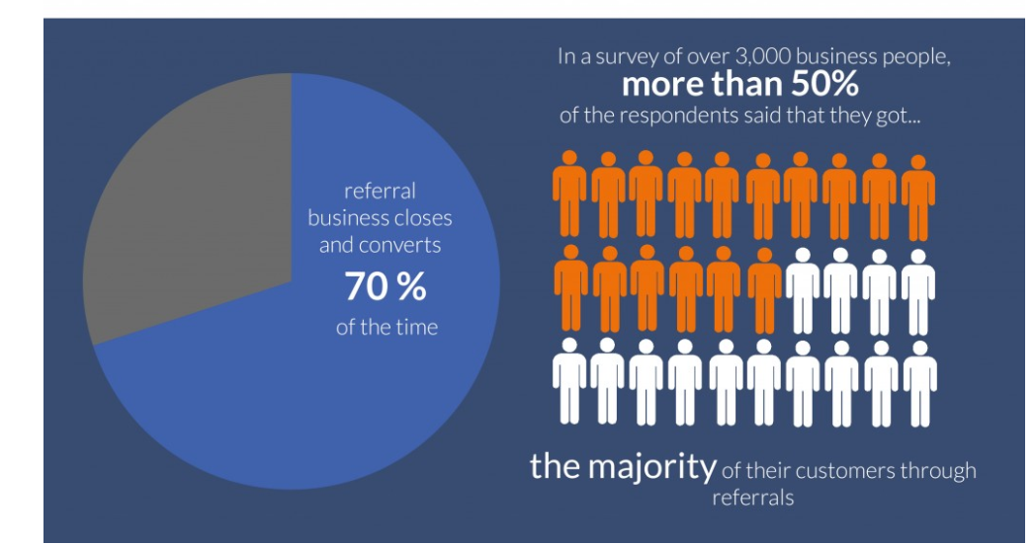
Background
Researcher said:
More than half of the respondents said that they got 70% of their customers through referrals. Referral converts 70% of the time.
Our company:
It is typically cheaper for us to acquire potential clients from referral than it is to advertise on website.
Source

Slide 5
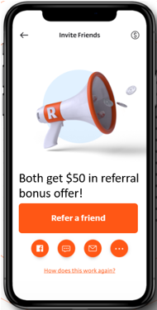
Background
Ctrl Always
Var 0-day
Var 2-day
Var 7-day
We decided to run an AB Test to find whether it will increase referrals if we:
a) Increase referral incentive from $25 to $50
b) Send the promo in 0/2/7 days after sender buys a policy

Slide 6
Executive Summary

Slide 7
Executive Summary
68%
Referrals
1.2X
Revenue
+55%
Profit
Recommendation
Suggest rolling out the $50 & 0-day referral program
Next step:
We could increase the frequency of reminder messages (ex. sending the promo again after 5 days) to see if it will generate more referrals
Another test: offer the cash reward after receiver buys a policy to see if it will increase policy conversions
Get real feedback from users who got $50 but did not buy policy eventually

Slide 8
Overall Analysis

Slide 9
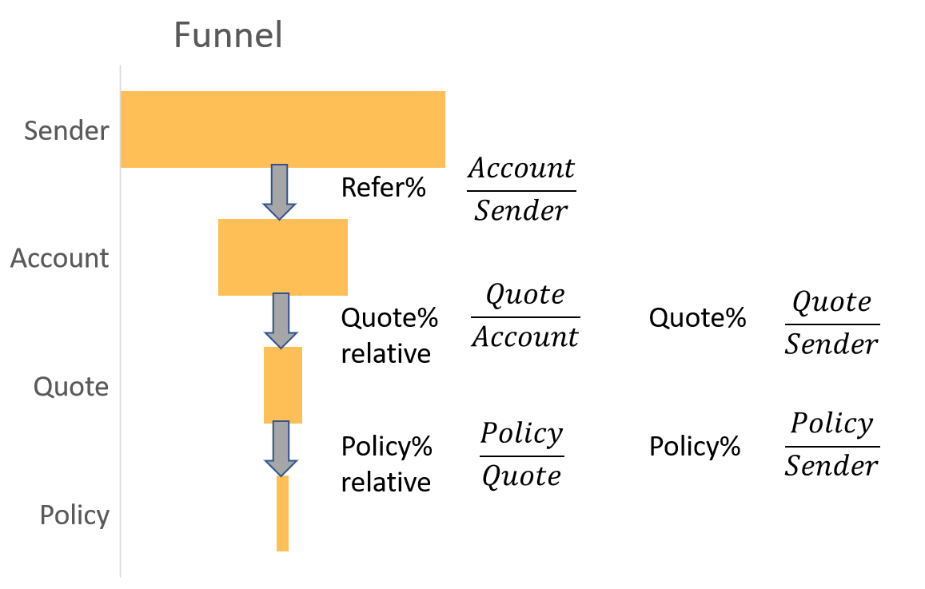
Business Flow

Slide 10
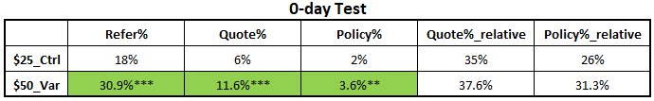
Reward Amount Test Analysis
*95% sig, **99% sig, ***99.9% sig
Significant
Ctrl
Var
* $50_Var 0-day group works well
(Refer% +12.5%, Quote% +5.3%, Policy% +2%)
* The more incentive does not increase the possibility for receiver to buy a policy

Slide 11
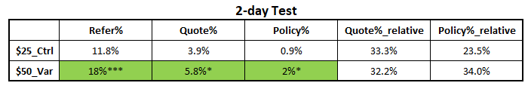
Reward Amount Test Analysis
Ctrl
Var
* $50_Var 2-day group also performs better
(Refer% +6.5%, Quote% +1.9%, Policy% +1%)

Slide 12
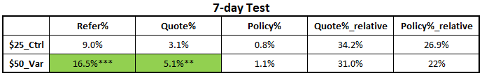
Reward Amount Test Analysis
Ctrl
Var
Based on all the three comparisons, $50 incentive attracts more referrals than $25.

Slide 13
Promo Begin Time Test Analysis
A
B
C
* 0-day Promo significantly performs better than 2/7-day Promo

Slide 14
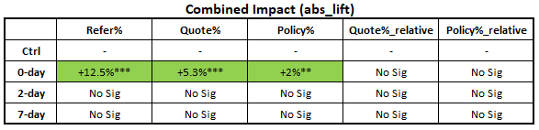
Combined Impact
Ctrl
A
B
C
Suggest rolling out $50 0-day test group
Increase Policy%_relative: run another test that offers the cash reward after receiver buys a policy
Collect feedback to increase policy conversions

Slide 15
Cost Benefit Analysis

Slide 16
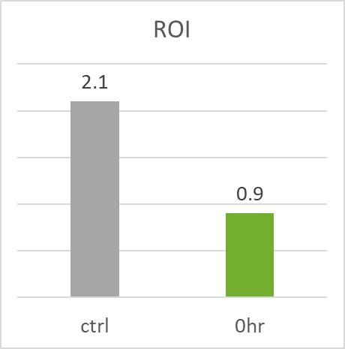
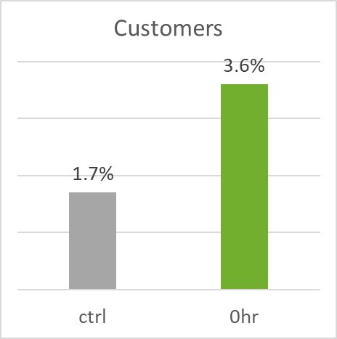
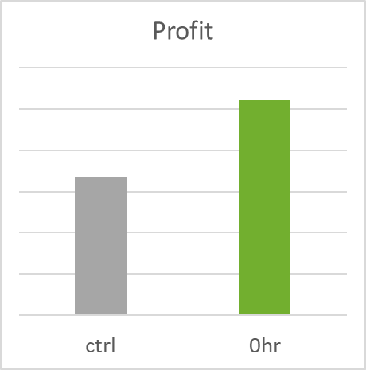
Cost
vs.
Benefit
+55%
The cost goes up because of the $50 0-day referral incentive, but the extra revenue generated covers the cost and brings in the highest total profit (+55%)

Slide 17
Finding & Conclusion

Slide 18
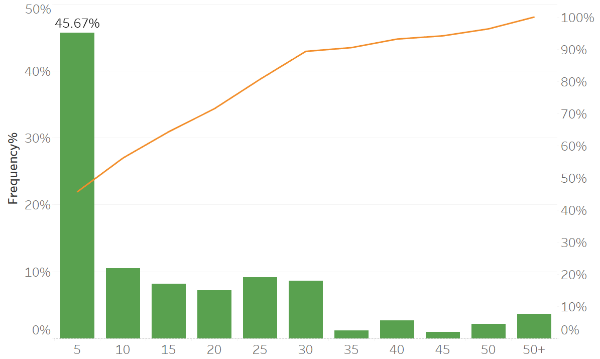
Finding
Findings:
Over 45% referrals have been created within 5 days after Promo
The promo effect declines significantly after 5 days
Recommendation:
We can send the promo again after 5 days, and test if it keeps increasing referrals
Referral Distribution

Slide 19

Conclusion
Var 0-day
I suggest we could turn the test off now and roll out the $50 0-day referral group, it will help us with customer growth (est. 120%) and boost profit (est. +55%)
Next step to test:
Resend the promo after 5 days
Offer cash reward after receivers convert
c) Get real feedback from receivers who did not buy a policy and collect their concerns
Ctrl Always
Var 2-day
Var 7-day

Slide 20

Thank you!

Slide 21
Appendix
Sample Size
* Note
There is no bias between the control group and test groups.
All the outliers have been removed from analysis.

Slide 22
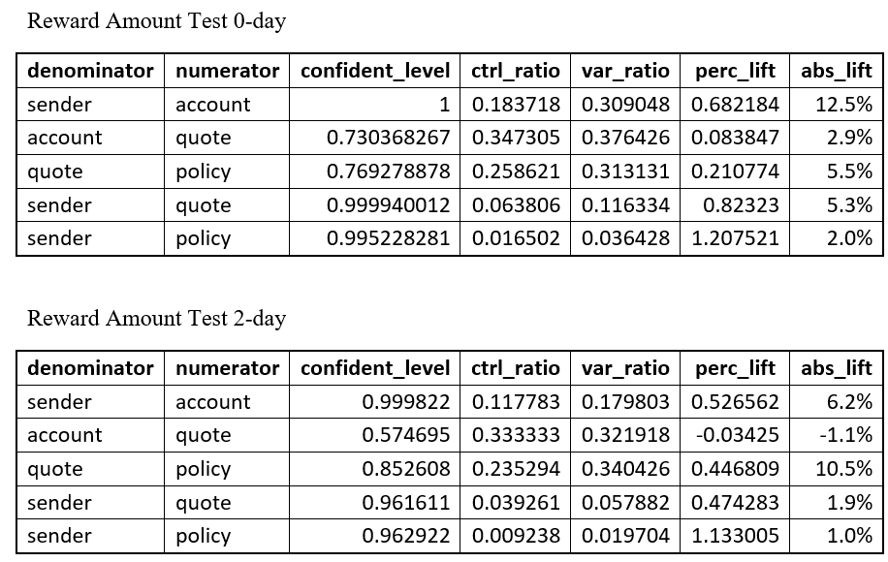
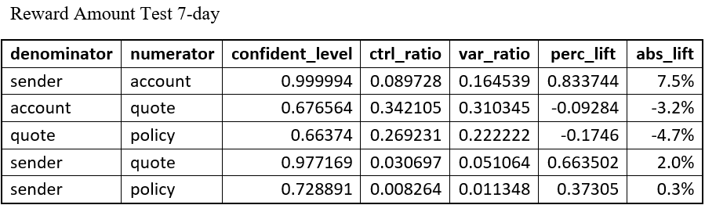
Appendix

Slide 23
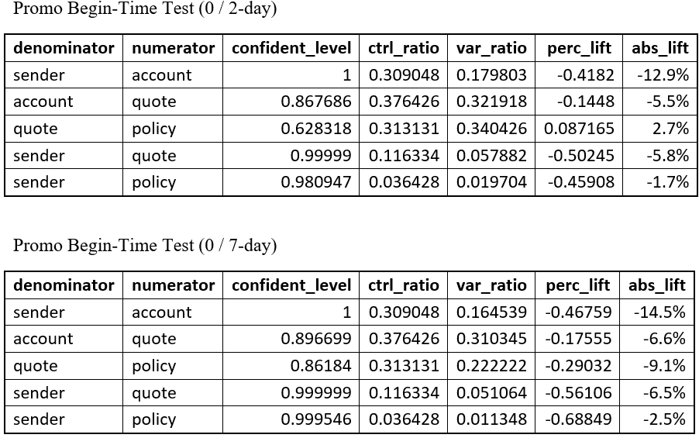
Appendix

Slide 24
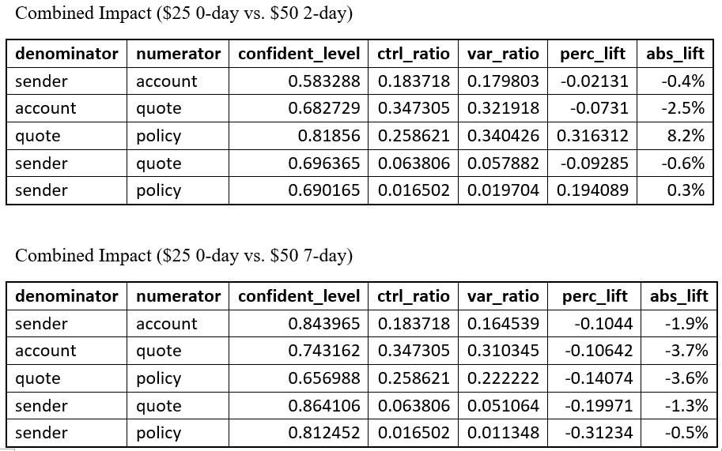
Appendix

Slide 25
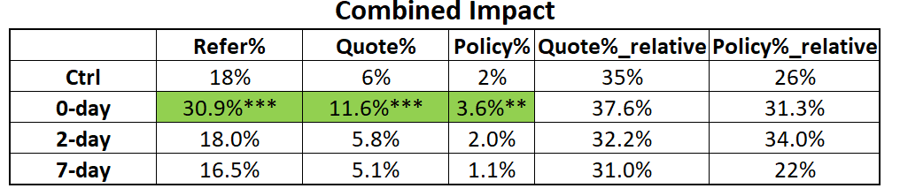
Appendix

Slide 26

Appendix
ROI
Assume the revenue per policy is $600/ 6 months
ROI =
$$\frac{\# policy ∗\$600 −\#quote ∗\$100}{\#quote ∗\$100}$$

Slide 27
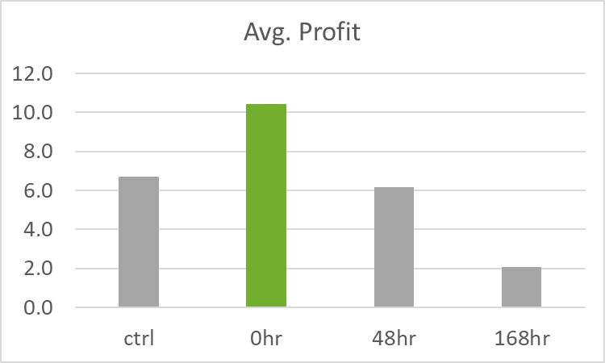
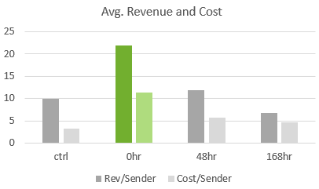
Appendix
Revenue, cost and profit for all test groups

